Slide 1
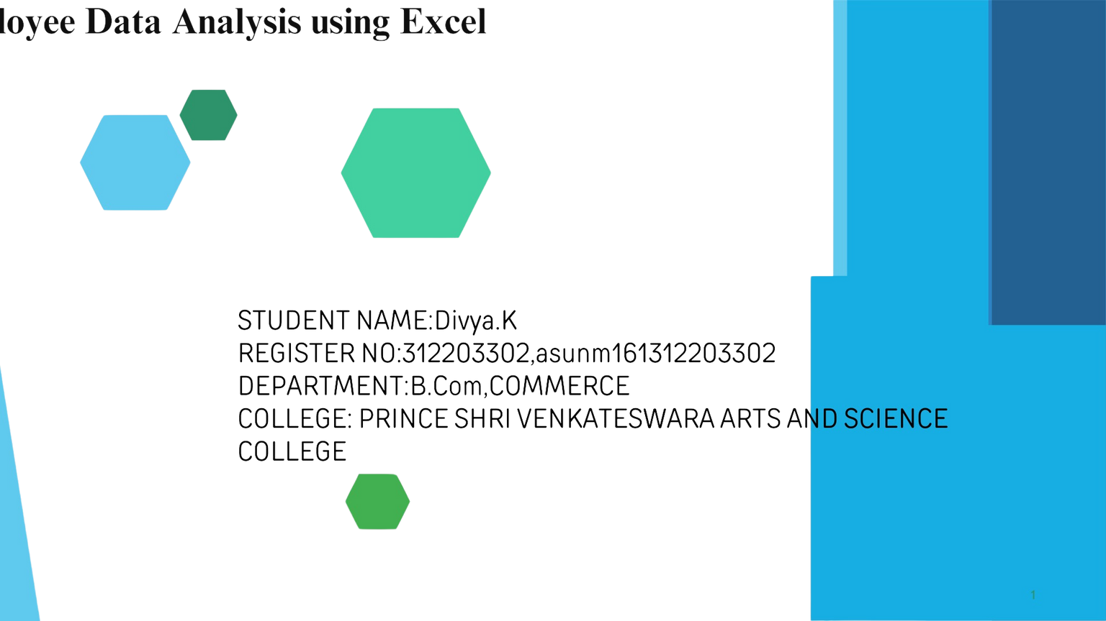
Employee Data Analysis Using Excel
STUDENT NAME: RAGHAVENDAR.K
REGISTER NO:312203128, asunm 133312203128,
DEPARTMENT:B.Com,COMMERCE
COLLEGE: ASAN MEMORIAL COLLEGE OF ART AND SCIENCE

Slide 2
PROJECT TITLE
Employee salary Analysis using Excel

Slide 3


AGENDA
I.Problem Statement
Project Overview
End Users
4.0ur Solution and
Proposition
5.Dataset Description 6.Modelling Approach
7.Results and Discussion
8. Conclusion
•

Slide 4



PROBLEM STATEMENT
Employee performance evaluations ar: conducted to:
Measure job performance.
Provide feedback and development.
Align goals with company objectives.
Inform compensation decisions.
Motivate employees.
Offer legal protection.
Aid in succession planning.
Identify training.
\

Slide 5


PROJECT OVERVIEW
Employee performance refers to how well an employee fulfills their job duties and contributes to organizational goals. It involves measuring productivity, quality of work, efficiency, and overall contribution. Evaluating employee performance helps identify strengths and areas for improvement, guides development and training, informs compensation decisions, and ensures alignment with company objectives. Effective performance management leads to motivated employees, better organizational outcomes, and a clear path for growth and development.

Slide 6
WHO ARE THE END USERS?
Chairman
Chief Executive Officer
(CEO)
1ark, ting Officials
•
unutn•R<.·sourc4.•s
Administrative
•
Professionals
OftirialN
Sall"'s Offi<"ials
•
Supen·i.sors
Secu•rit) Staff
ct .i•.ner,o,;

Slide 7




OUR SOLUTION AND ITS VALUE PROPOSITI
Conditi l formatting using
=IFS(GlO>=l,"applicable",GlO>=l,"not applicable",G10=1,"pe
Usage of pivot table ,pie chart and bar graph

Slide 8


Dataset Description
downloaded employee data set using- kaggle
features used:
Emp ID
Name
Gender
Department
Salary
Start Date
FTE
Employee type
Work location
Eligibility

Slide 9


THE ''WOW'' IN OUR SOLUTION
IFS(GlO>=l,"applicable",GlO>=l,"not applic le",GlO=l," perfect")
Pivot table,pie chart and bargraph Highlighting the features
Interpreting the salary of each individual

Slide 10

MODELLING
Dowloaded employee data sheet from kaggle
selected 20 datasets in the downloaded data sheet and created a new data sheet 3.Highlighted the features used in the data sheet
select the employee performance and done the Eligibility status
create the pivot column and created pie chart and bar graph
Made analysis using the bargraph

Slide 11

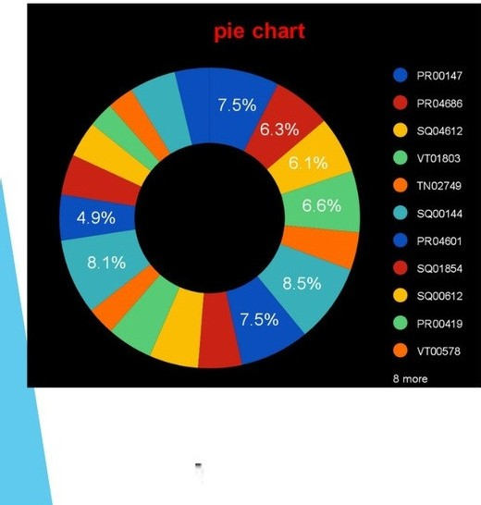
RESULT
s
125
000
100
000
750
00
500
00
250
00
Bar graph
0
q�··4?···· 0··.s-·· --· o· -·· o·· o-· --·.s--- -..q · ...s-·.. o·..
··.s-·.. o·.. ..
Start Date ■ Salary

Slide 12




conclusion
In conclusion, effective employee performance management is essential for
individual and organizational success. It ensures that employees are meetin
expectations, contributing to the company's goals, and continuously developing skills. Regular performance evaluations not only drive motivation and pnoductivi also enable informed decisions regarding promotions, compensatio171, and car
development. Ultimately, a strong focus on employee performance l ads to a
engaged, efficient, and successful workforce.

